Slide 1

The Turkey’s dream of becoming member of the European Union exist since 1963 when the agreement of association to the European Economic Community foresaw explicit the possibility of becoming a member of it. Still, 36 years were necessary for Turkey to be recognized as a candidate state and another 6 years until the negotiation started. We would like to invite you to analyze the pro and against arguments regarding the Turkey’s integration in the EU. The debate is even more interesting for the Romanians because we are the strongest European upholders of the Turkey’s integration due to the important cultural, economic and geostrategic relationships between the two countries.
The first Romanian-Turkish contacts are from the end of the 14th century when the Rulers of Wallachia started to send messengers to the High Port. Subsequent, starting with the 16th century it had been set up the tradition of representing the Romanian rulers through diplomatic agents, known as ,,capuchehaia”, residents in the Ottoman capital.
Interrupted in 1877, the diplomatic relationships were re-established at the legation level in November 1878.
In 1938 the relationships between the two states were raised at embassy level.
In November 2008, we celebrated 130 years from the starting point of the diplomatic relationships between Romanian and Turkey, event marked by organizing by both sides: Romanian and Turkish , of an exhibition of diplomatic documents at București and Ankara.

Slide 2
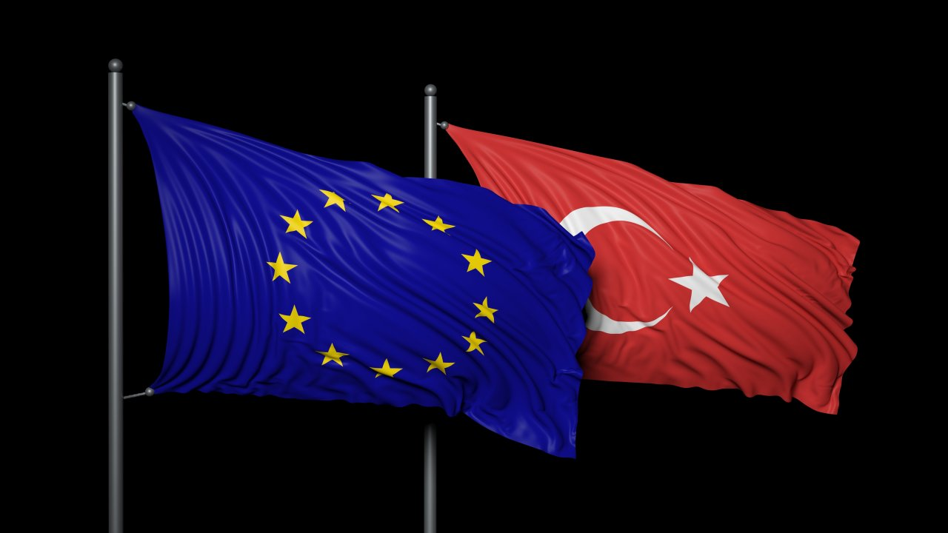
Pro arguments
First, it should be mentioned that Turkey has an exceptional geographical positioning, being part of no less than 4 regional subsystems: Mediterranean Sea, Middle East, the Balkans and the Caucasus. Therefore it is a terrestrial and aerial bridge between Europe and Asia; maritime as well between the Mediterranean and the Slavic space. A Turkey member of the EU could place Europe in the centre of the international scene gaining a major power in the ,,hottest” area of the world. Like this the European Union would gain the strategic control over the sweet water of Iraq, Gulf and the Near East. More than that if it were to believe the theory of domino an European Turkey would promote, on the one hand, the values of democracy in an area of conflict and deeply unstable ( the Caucasus, the Middle East ) and on the other hand could be a symbol of a cultural and religious tolerance which would combat the ,,clash of civilization” theory.

Slide 3
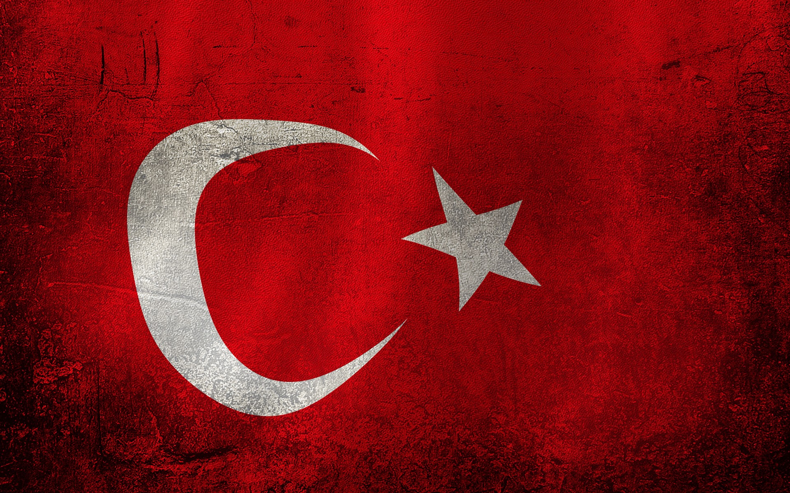
Turkey’s economic, strategic and human potential
More than that due to its location and by playing the geopolitical water strategy Turkey would facilitate the UE’s supply with gas and petrol. It would also make secure the energetic routes taking into consideration the important resources from the Caspian Sea, the Middle East and Central Asia. Like this Europe would be located at the gates of Iraq, Kuwait, Iran , Saudi Arabia and even Turkmenistan via the Caspian Sea.
Also, the integration of Turkey in the EU would mean for Europe a huge economic market and this market would be as competitive as the Eastern Europe markets. With an 800 000 km2 and a population of more than 70 million inhabitants Turkey could assure an important potential of economical grow and on the other hand would solve the aging problems of the European labour market because of the demographic advantage of an young population.

Slide 4
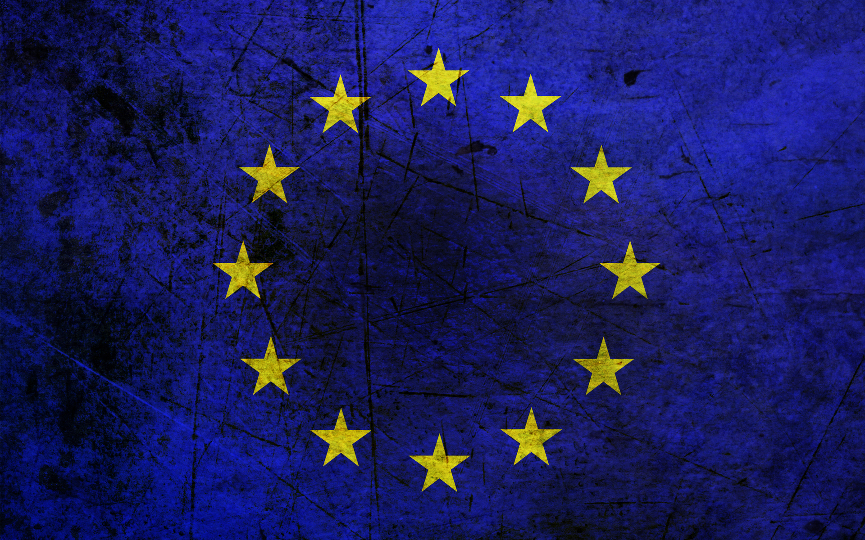
GEOSTRATEGIC ARGUMENTS AGAINST TURKEY’S ADHERENCE TO THE EU
Identity factors and import of insecurity
The most important argument against Turkey’s adherence to the EU is the identity factor. Although there isn’t an agreement in what concerns the geographical and cultural limits of the Europe we can not deny the mix euro-asian nature of this country. If Turkey adhere to the EU we will be neighbors with a series of unstable countries like: Siria ( turf war with Israel on the Golan Heights ) , Armenia ( frozen conflict from Nagorno Karabach ), Iraq or Iran. To this internal instability of this countries we add the tense relationships of Turkey with most of its neighbors. This factor would export insecurity inside EU. We talk here about the problems with Syria and Iraq regarding the barrage built on Tiber and Euphrates which limit the resources of water in downstream, about the historical conflict with Armenia regarding the genocide from the beginning of the previous century, about problems with Greece and Cyprus regarding the Island of Cyprus or tensions with Iraq regarding the Kurd minority.
The issue of Kurd minority has an important geopolitical aspect which is an argument against Turkey’s adherence to the EU. So, the Kurd minority, the most numerous minority in the world without a country is spread all over Western Asia, especially at the border between Turkey, Iraq, Syria and Iran.

Slide 5
Taking into consideration the fact that the majority of Kurdish people are located in the East of Turkey ( almost 20 millions ) and that they have frequently self-governing tendency, the Kurdish problem would come with another source of instability inside EU.
We add to this the long existing problem of the Island of Cyprus which creates , maybe, the most serious strategic difficulty.
Therefore, the north side of the island, proclaimed ,,The Turkish Republic of Northern Cyprus” is under Turkish occupation since 1974 and, more than that, Turkey does not recognize the existence of the of the state of Cyprus (the south part of the island ), an EU member since 2004. The situation is quite paradoxical: Turkey, candidate to adherence to the EU is an occupying force of an another member state which, more than that, does not recognize it. It is hard to believe that in this conditions Cyprus will agree to vote for Turkey’s adherence to EU if we take into consideration the fact that all member states should vote for.

Slide 6
Possible demographic and economic threatens.
Although we saw on our previous slides that the demographic factor can play a positive role to Turkey’s adherence to the EU, it can also be an element of concern. This is linked to the size of population and the constant grow of it which would assure Turkey the first position in terms of influence in the communitarian institutions. From this position, Turkey would influence in a decisive way the European policy views.
Taking into consideration all of this it is easy to understand why the issue of Turkey’s adherence raise so many debates.

Slide 7
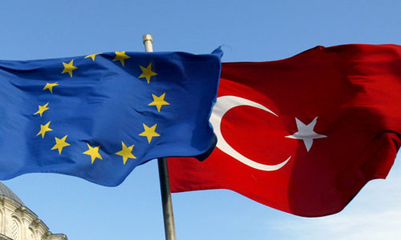
The choice of adherence and non adherence should take into consideration both the advantages and problems which EU could face but also the fact that leaving Turkey outside EU could lead this country to some non democratic paths just like it was in an not far away past.

Slide 8

Who knows…… perhaps….. Turkey's EU membership will be a good thing.

Slide 9
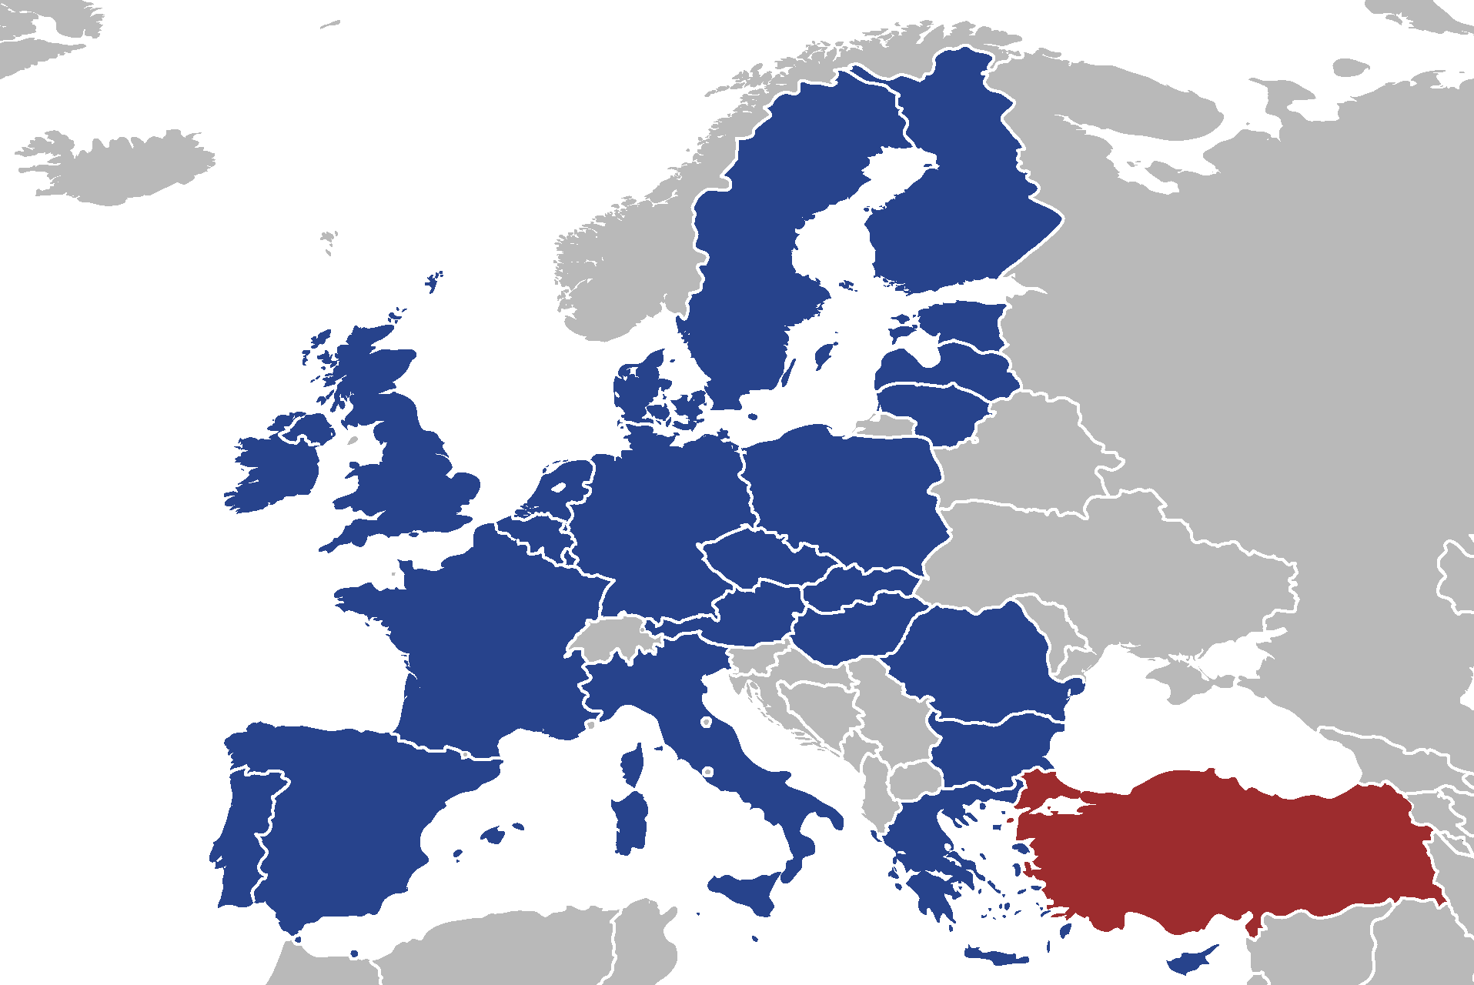
Or not ... ☹

